Slide 1
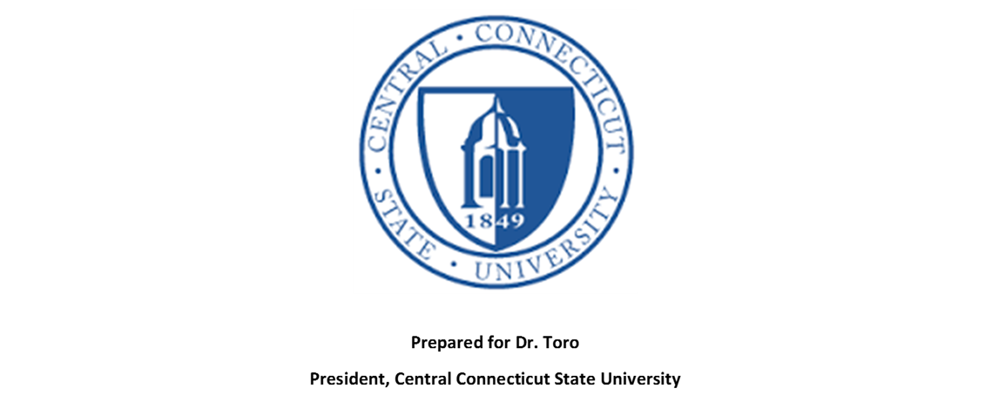
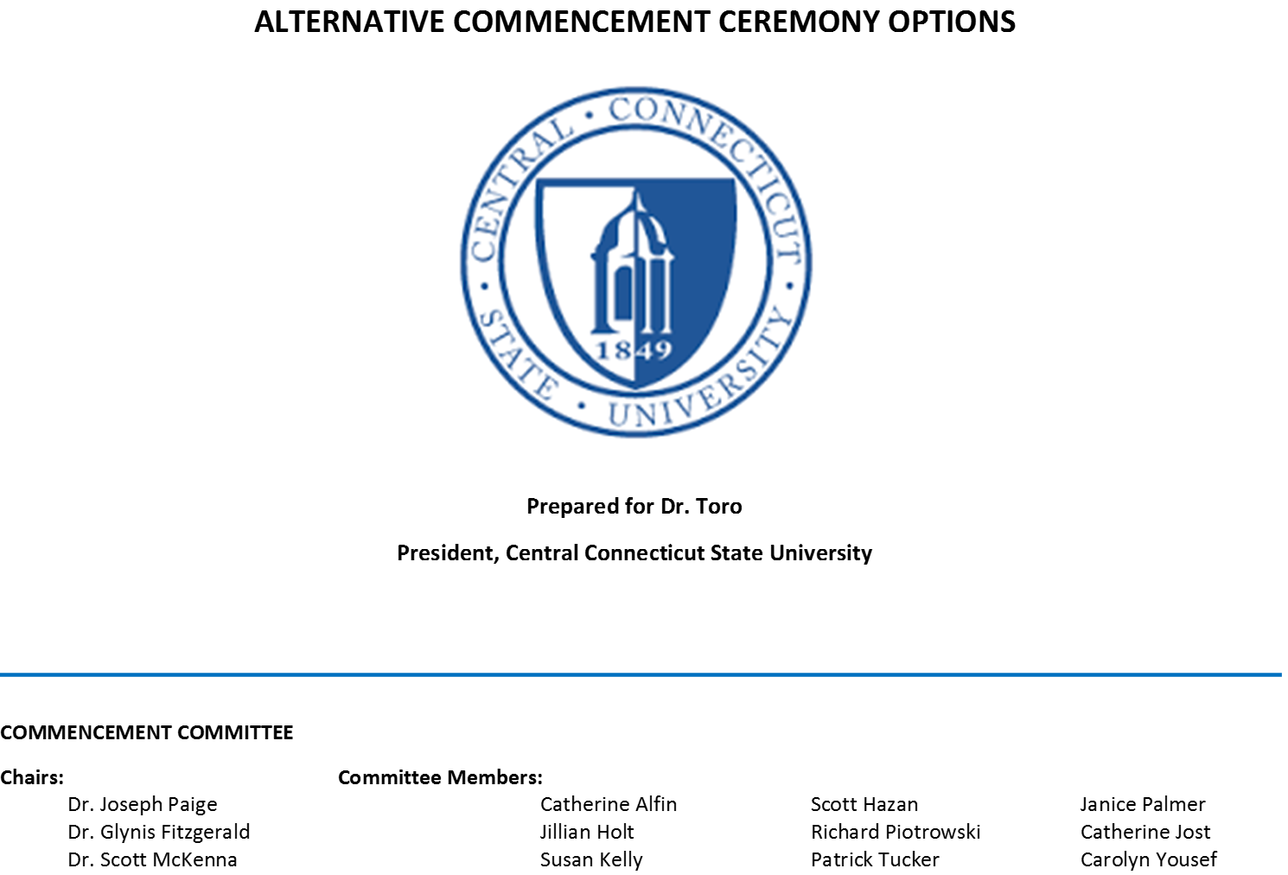
Commencement Ceremonies at Comparable Institutions

Slide 2
REPORT NOTES
The committee contacted many institutions requesting information about their commencement ceremonies; however, very few responded. With time being of the essence, the committee opted to augment the information we had gathered through our survey with web searches, which included photographs of recent commencement ceremonies. This report provides a general overview of commencement ceremonies performed at comparable institutions and more importantly at strong, well-known institutions. If necessary, the committee will continue to build upon this information until such time that we have a complete report for the included institutions.

Slide 4
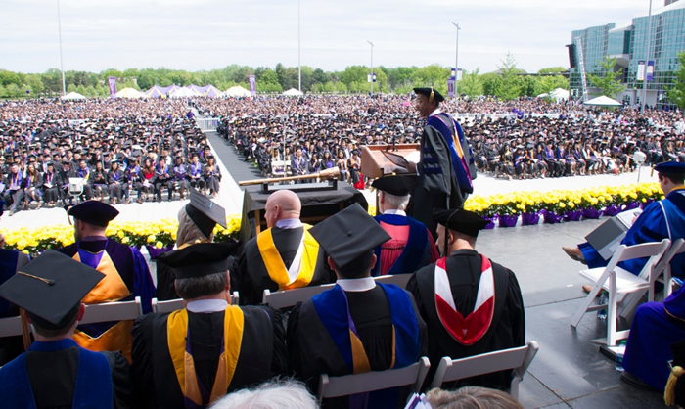
Albany State University

Slide 5
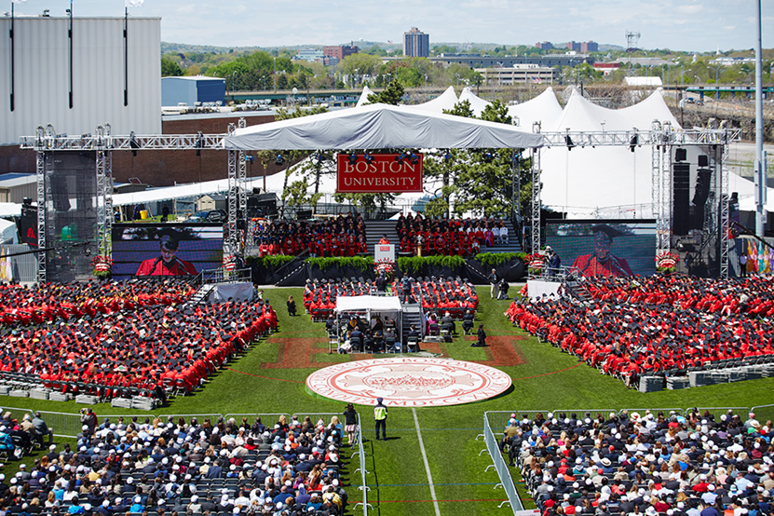
Boston University

Slide 6
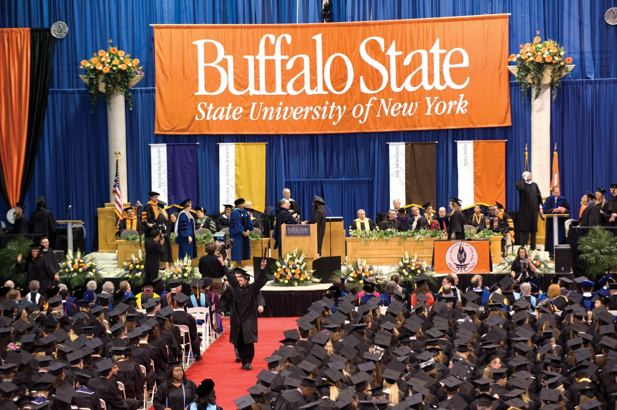
Buffalo State SUNY

Slide 7
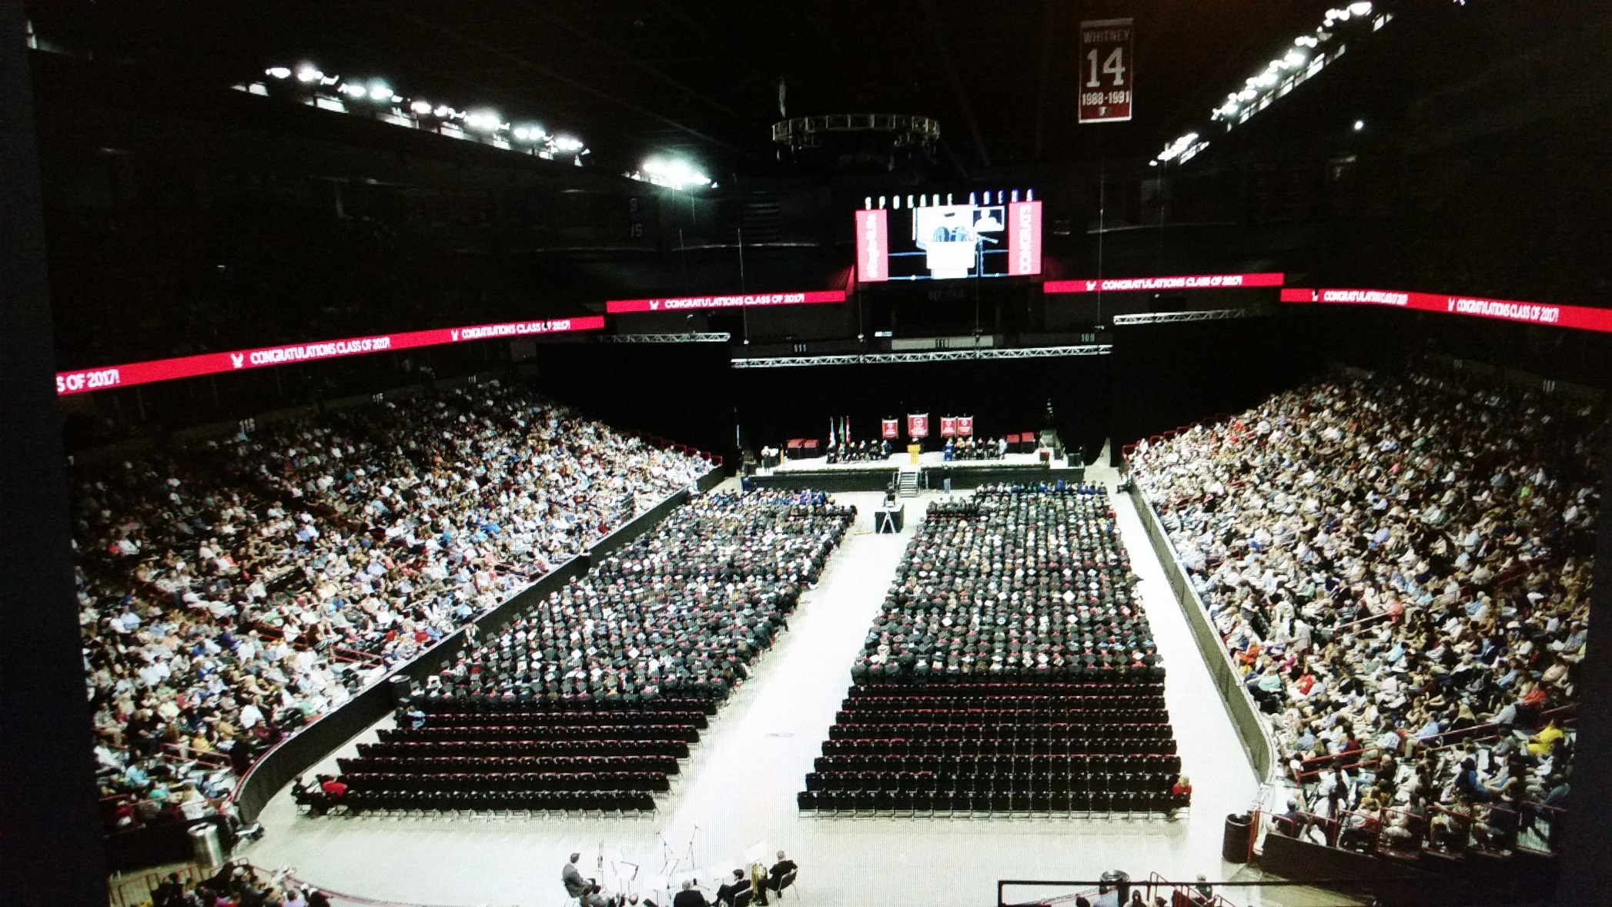
Eastern Washington University

Slide 8
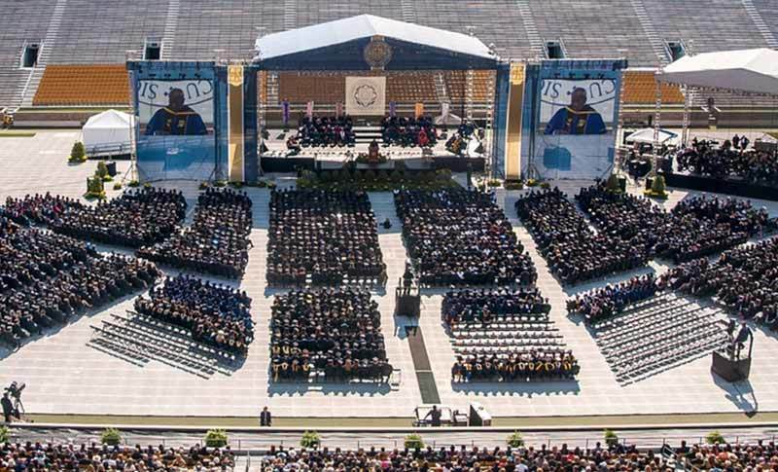
Notre Dame

Slide 9
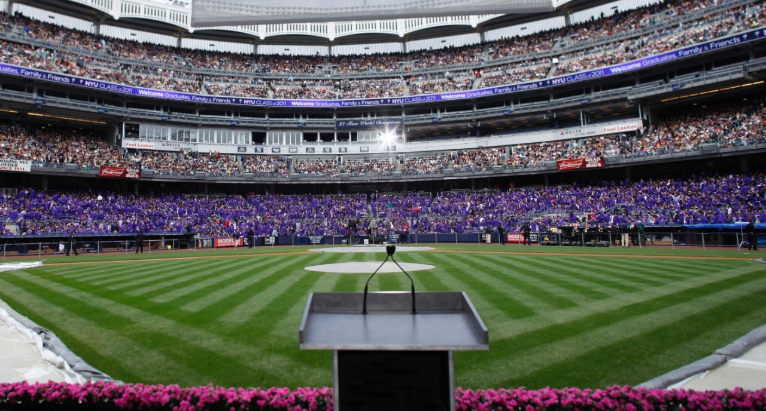
NYU

Slide 10
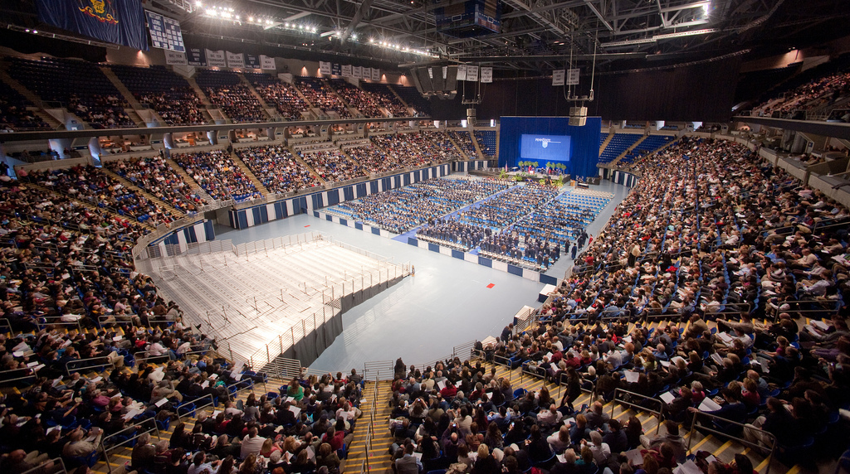
Penn State

Slide 11
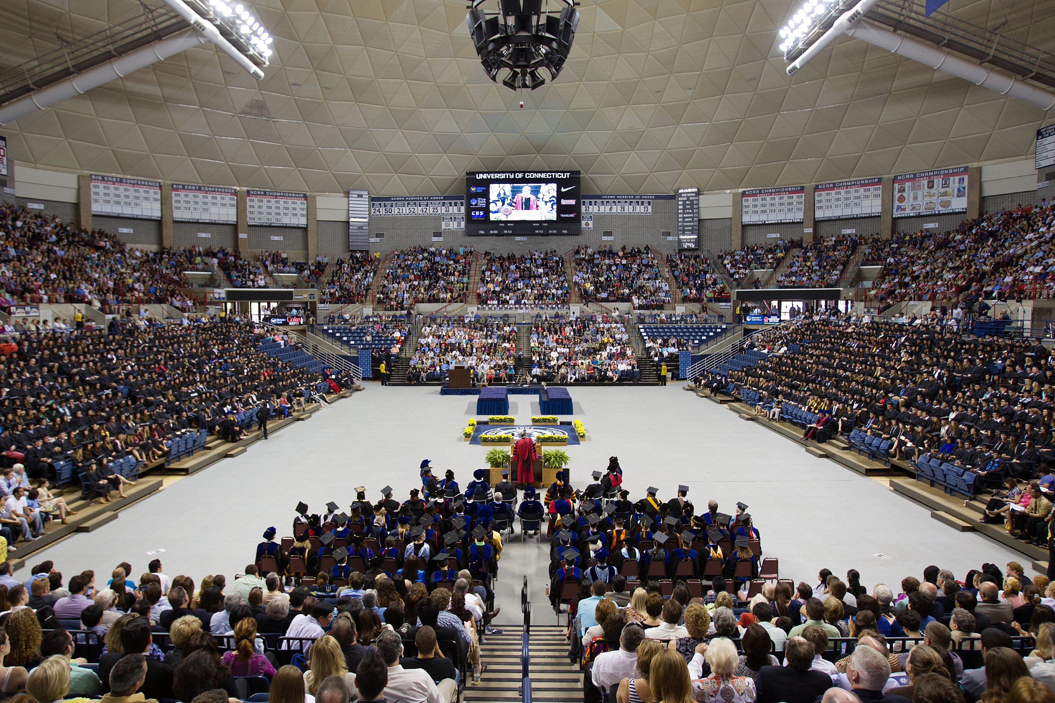
UCONN

Slide 12
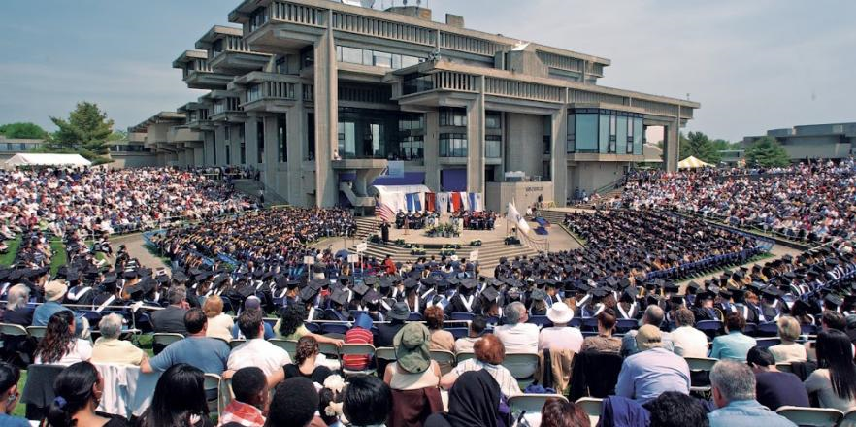
UMASS - Dartmouth

Slide 13
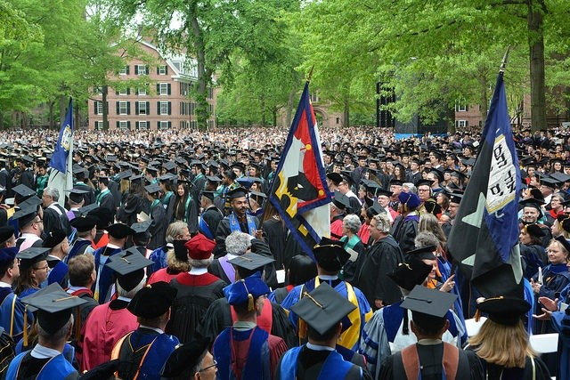
Yale

